Slide 1
Digihaul Data Analyst – Business Case
Jordan Anyanwu

Slide 2
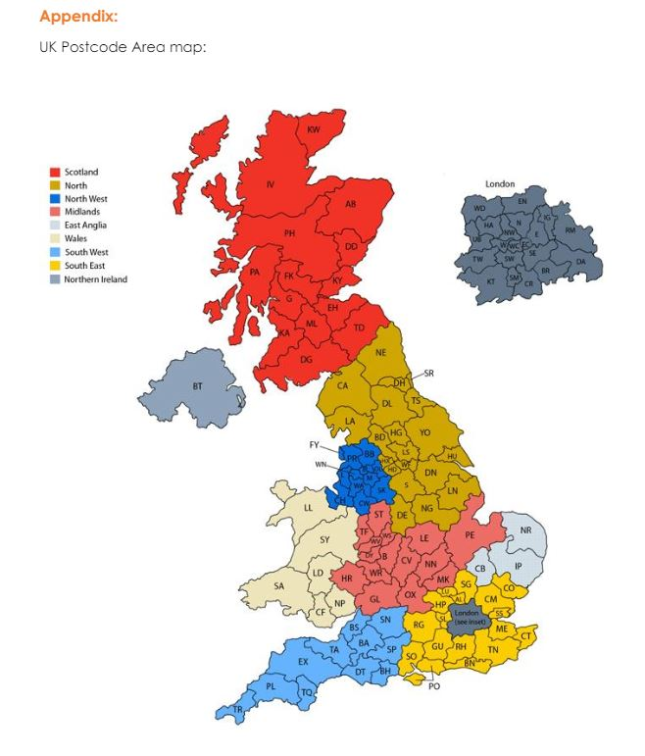
Task Given: Analyse the two datasets to: - Qualify which factors seen to influence our competitor’s pricing - Identify trends on variation of rates over time and across regions - Demonstrate how Digihaul rates compare to competitor’s rates - Identifying other insights that can be extracted from the data. NB: The analysis of the dataset given was performed using Microsoft Excel

Slide 3
Factors Influencing Competitor’s Pricing
Below are factors that I have considered in being able to influence/affect Digihaul’s competitor’s pricing;
Road routes
Delivery Areas in designated regions
Vehicle Capacity

Slide 4
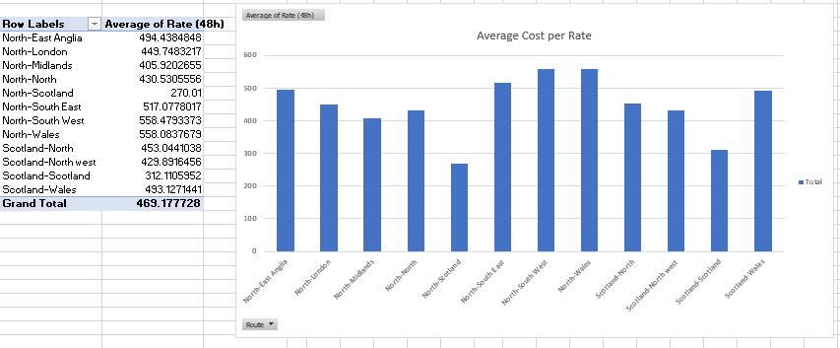
Average rates charged based on transportation between regions on a 48 hour lead time.
Road Routes: the routes taken on roads to deliver between lanes, e.g., CA – DN, (CA1 1AA – DN1 1AB , a lane that goes from an origin in Carlisle located in the northern region of England, to a destination in Doncaster that is also northern England), is a factor that can contribute to influencing our competitor’s pricing, assuming our competitor are deploying a route between lanes that cover less roads. This will reduce their average rate, due to a low cost of services, such as expenditure on fuel and maintenance of vehicles will be low, allowing them to charge a lower rate for different lanes, and vice versa, in an opposite outcome our competitor’s will charge higher rates.
Vehicle capacity (total load) is a factor that can be considered, to influence our competitor’s pricing, which accounts for how much storage a transportation vehicle will have to carry and deliver “x” amounts of goods between an origin and destination. For example, the lane from DN1 1AB to NN1 1AF, North to the midlands, in week 15 had a high total load of 161, hence if our competitors have a low vehicle capacities, this will result to employing more vehicles to transport more products in a lane, leading to more costs.
Distance: Another major factor that influence competitor’s pricing, is the distance that must be travelled to transport products, as seen in the datasets given, the rates tend to vary a lot depending on different regions transferred to and from.

Slide 5
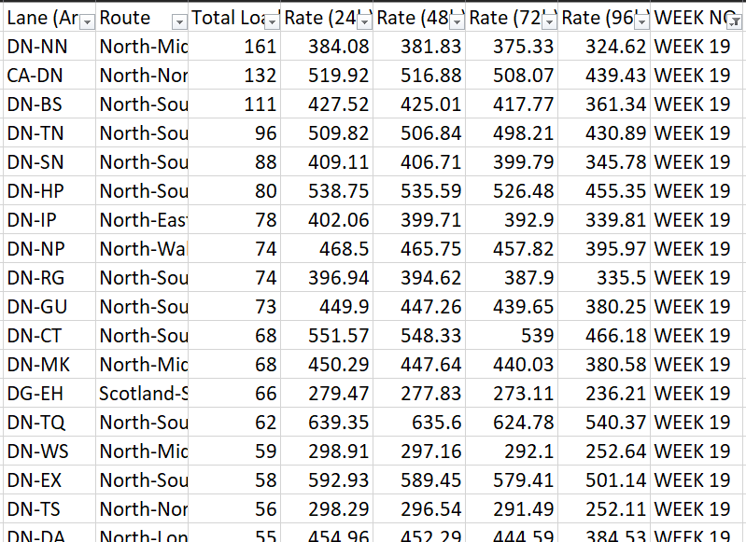
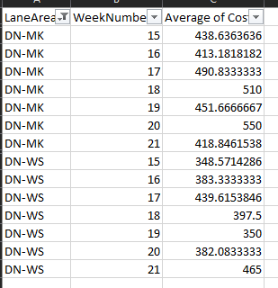
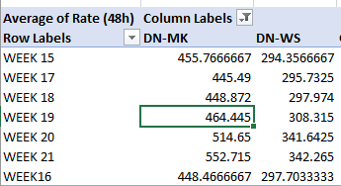
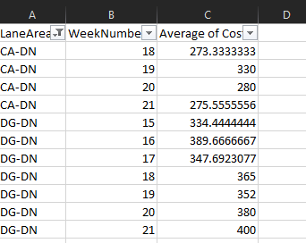
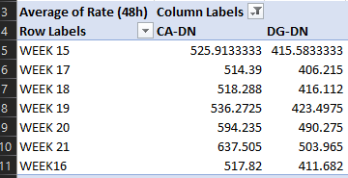
Trends on variation of rates over time and across regions
The rates for Digihaul varied a lot, as they were seen to be fluctuating, e.g. going from £438 to £413 and back to £490, in the span of three weeks ( lane DN – MK, week 15 to 17), with a variety of high rates across regions, some regions were seen to have a similar range of rates to each other, as seen between lane DN-WS and DG-DN. With destinated regions that were farther from the origin, the rates/prices tended to be higher than closer ones. For the competitor, the rates were mostly similar in rates, with few regions/routes having higher rates than the others. Over the range of the 7 weeks recorded dataset given, after analysis of the dataset it was identified that some lanes had a gradual decrease in the rates, e.g. lane DN – WS. In some weeks like the weeks recorded for lane DG-DN there were often gradual decrease or increase or even fluctuation in rates, followed by an unexpected high increase or decrease in rates. So, the variation of rates across region and over time were similar or had the same effect on the trend of the variation of rates.
A sample of Digihaul’s analysed data of two lanes
A Sample of Competitor analysed data on two lanes
A Sample of Competitor data on two lane
A sample of Digihaul’s analysed data on two lanes

Slide 6
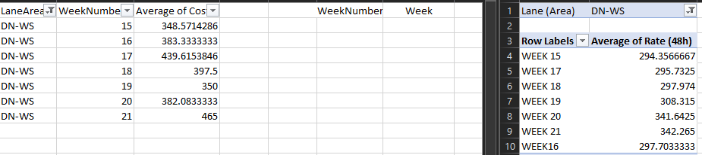
Comparing Digihaul rates to competitor’s rates
Based on the analysis of the datasets given, for identical lanes recorded for both Digihaul and our competitor, Digihaul had a higher rate/average of cost (48hr) in general when making comparison to our competitor dataset. Below are some comparisons between rates of Digihaul and its competitor;
DN – IP
(North to East Anglia)
DG – EH
(Scotland to Scotland)
DN-WS
(North to Midlands)
CA – NN
(North to North)
For Digihaul, the lane CA-NN, had a lower average rate than our competitor in general, with Digihaul lowest rate being £273.33 in week 18, while our competitor’s rates were on higher pricing at £518.28. even when comparing our highest rate charged in week 19, which was £330, we were still lower than all our competitor’s rate.
In this lane, our competitor’s rate over the course of the 7 weeks, was lower than our average rate excluding week 19, the average cost in this lane was very high in comparisons to our other lanes average cost, our highest cost was 526.88 (rounded up) while our competitor highest cost was 493.52
In this lane, transportation between the region of Scotland, resulted in a similar range of average cost between Digihaul and our competitor, however our competitor had a lower average/individual rate in this region and over the 7 weeks periods when taken into consideration
In this lane, over the course of the 7 weeks period given, our competitor rates were lower than Digihaul, with the lowest rates between each other was Digihaul with 348.57 and competitor with 294.35, over the 7-weeks there wasn’t a week where our rate was lower than our competitor’s rates, as seen in the data our highest increase in rate for this laner was from week 20 to week 21, where our rate rose from 382.08 to 465. For such week, our competitor did not see a significant increase in their rate. Figure 1, Digihaul on the left, competitor on the right
Data analysis on the DN – WS lane for Digihaul and Competitor (figure 1)

Slide 7
Other Insights that can be extracted from the data
Additional insights can be attained from the analysed dataset to help Digihaul run or operate its businesses in a better way, some are as followed;
Suggestion to improve or find better routes between lanes, to ensure that lesser roads are covered, to reduce cost of services, leading to a lower average cost/rate for Digihaul, acting upon this will result to a higher profit margin for the business, as it will allow Digihaul to retain more of its revenue as profits.
Other insights from the data extracted and analysed, is revealing which business is currently more dominant in their market and how they can strategize on how to improve their business.
With the extracted and analysed data showing differences in rates between Digihaul and its competitor over the time frame, an insight to consider is that Digihaul may choose to reduce price, however these are all assuming that the clients/customers in this market/industry are incentivised by cheaper prices.

Slide 8
Summary of work
NB: In the excel file showing my works of data analysis, a selection of few rows were hidden to present the file as neat, tidy and concise.
Offering insights that can be identified from the data
Give numerical analysis of datasets, like average costs, sum, etc.
With the given task and using dataset 1 and dataset 2, I have been able present these skills in data analysis;
Data cleansing
Data modelling
Data visualization

Slide 9
Thank you!
Jordan Anyanwu

